Slide 1

NEUTRINOS IN NUCLEAR PHYSICS
Ben Jones, University of Texas at Arlington

Slide 2

On the menu
L1:
Neutrinos in β decay
Reactor neutrinos
Endpoint ν mass searches
L2:
Solar neutrinos
Neutrino oscillations
MSW effect
L3:
Majorana v. Dirac
Double beta decay
L4:
Atmospheric neutrinos
Accelerator neutrinos
Gallium anomaly
Sterile neutrinos, etc
I have been asked to cover all of neutrino physics in 4 lectures, which is clearly impossible.
Instead, you get a mix of:
Historical things
Pedagogical things
Breaking news
My own opinions about things

Slide 3
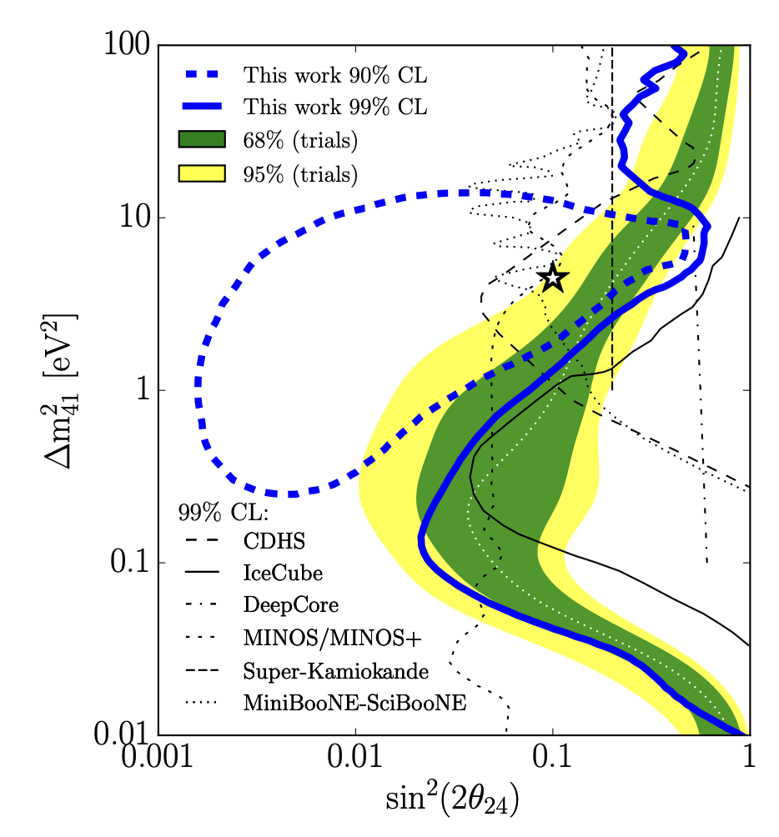
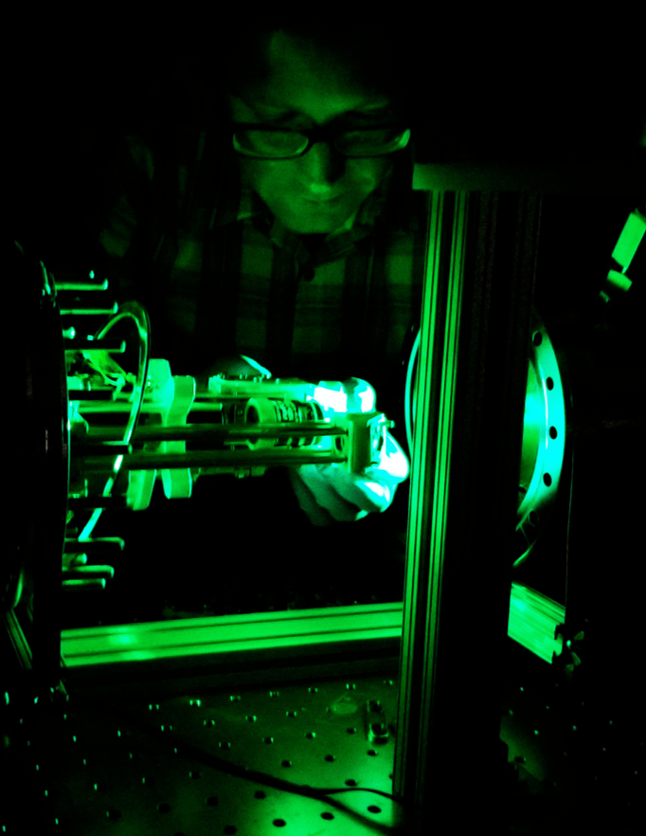
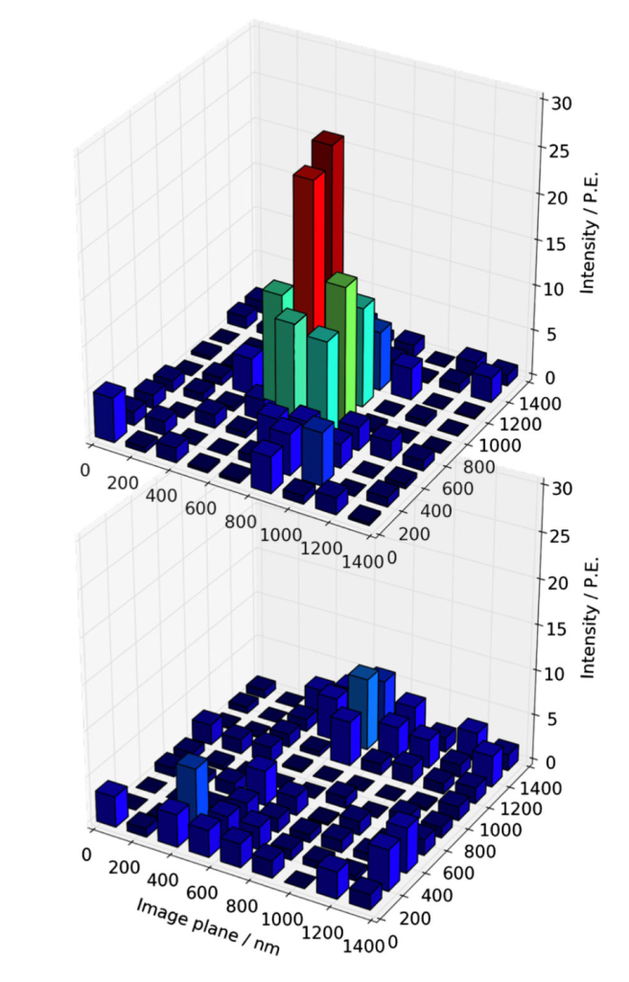
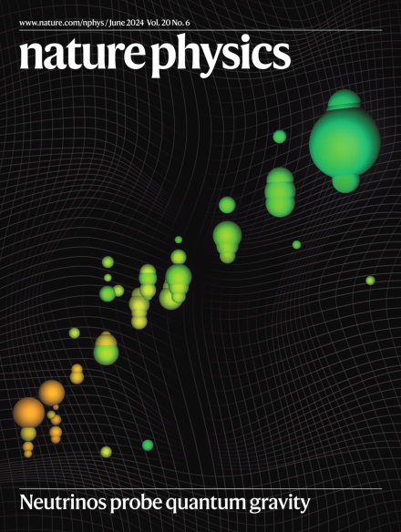
About me…
Career path:
BA M.Sci at Cambridge
PhD at MIT 2009-2015
Postdoc at UTA 2015-2016
Prof at UTA 2016-present.
Main things I have worked on:
MicroBooNE (2009-2015)
SBN Accelerator ν; worked on liquid argon TPC technology focused on optical systems and properties.
IceCube (2013-2023)
Atmospheric and Astro ν; led high energy oscillation analyses including worlds best limits on sterile ν, quantum gravity & NSI.
NEXT (2016-present)
0nubb search in xenon gas; developed single Ba²⁺ tagging techniques and led US contributions to NEXT-White and NEXT-100.
Project 8 (2023-present)
Direct ν mass search; working on magnetic evaporative cooling beamline for atomic tritium source.
Creative bits and pieces
I also like to explore new ideas in neutrino pheno and experiment concepts – its fun to be creative!
My Group Website: https://nures.uta.edu/

Slide 4
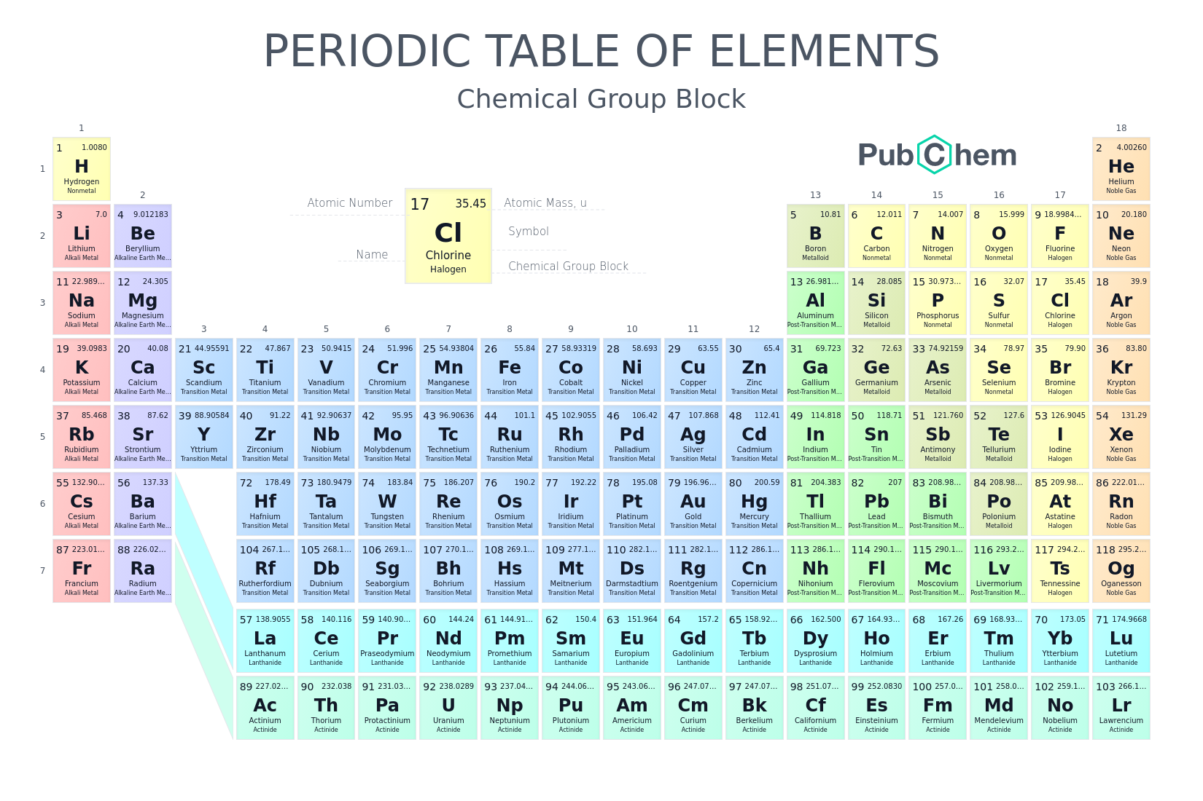

Beta decay as alchemy:
p→n+e⁺ (β⁺ decay)
n→p+e⁻ (β⁻ decay)
Energy available in the decay is the mass difference between initial and final nuclei (n.b., final one may be in excited state)

Slide 5
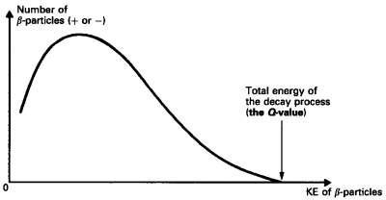
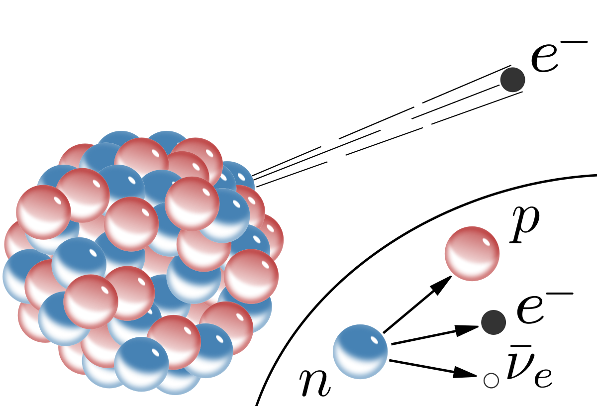
If you measure the energy of the electron in beta decay you get a continuous energy distribution.

Slide 6
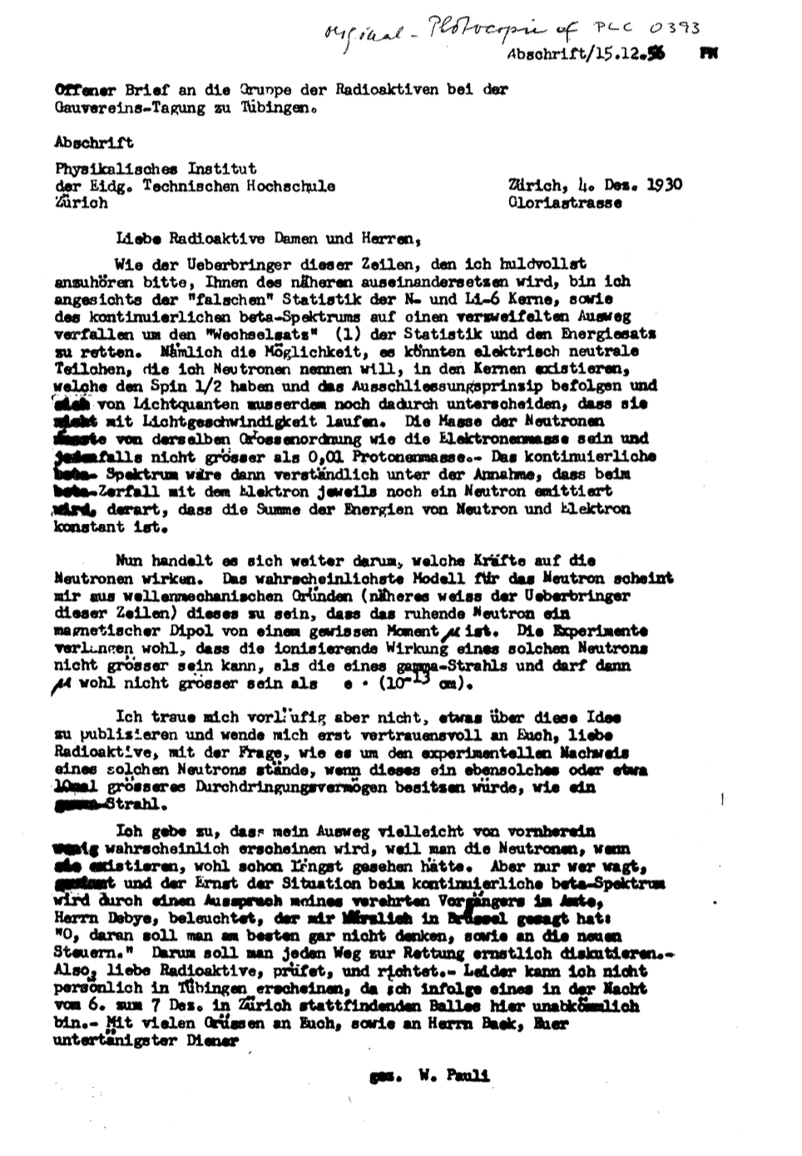
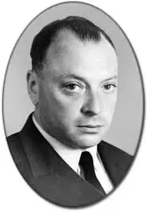
A bold idea…
Apparent momentum non-conservation in beta decay led Pauli to propose the existence of an “undetectable” particle in a now famous letter:
Wolfgang Pauli, 1930

Slide 7
Dear Radioactive Ladies and Gentlemen,
As the bearer of these lines, to whom I graciously ask you to listen, will explain to you in more detail, because of the "wrong" statistics of the N- and Li-6 nuclei and the continuous beta spectrum, I have hit upon a desperate remedy to save the "exchange theorem" (1) of statistics and the law of conservation of energy. Namely, the possibility that in the nuclei there could exist electrically neutral particles, which I will call neutrons, that have spin 1/2 and obey the exclusion principle and that further differ from light quanta in that they do not travel with the velocity of light.
The mass of the neutrons should be of the same order of magnitude as the electron mass and in any event not larger than 0.01 proton mass. - The continuous beta spectrum would then make sense with the assumption that in beta decay, in addition to the electron, a neutron is emitted such that the sum of the energies of neutron and electron is constant.
Now it is also a question of which forces act upon neutrons. For me, the most likely model for the neutron seems to be, for wave-mechanical reasons (the bearer of these lines knows more), that the neutron at rest is a magnetic dipole with a certain moment μ. The experiments seem to require that the ionizing effect of such a neutron can not be bigger than the one of a gamma-ray, and then μ is probably not allowed to be larger than e • (10-13cm).
But so far I do not dare to publish anything about this idea, and trustfully turn first to you, dear radioactive people, with the question of how likely it is to find experimental evidence for such a neutron if it would have the same or perhaps a 10 times larger ability to get through [material] than a gamma-ray.
I admit that my remedy may seem almost improbable because one probably would have seen those neutrons, if they exist, for a long time. But nothing ventured, nothing gained, and the seriousness of the situation, due to the continuous structure of the beta spectrum, is illuminated by a remark of my honored predecessor, Mr Debye, who told me recently in Bruxelles: "Oh, It's better not to think about this at all, like new taxes." Therefore one should seriously discuss every way of rescue.
Thus, dear radioactive people, scrutinize and judge. - Unfortunately, I cannot personally appear in Tübingen since I am indispensable here in Zürich because of a ball on the night from December 6 to 7. With my best regards to you, and also to Mr. Back, your humble servant
signed W. Pauli

Slide 8
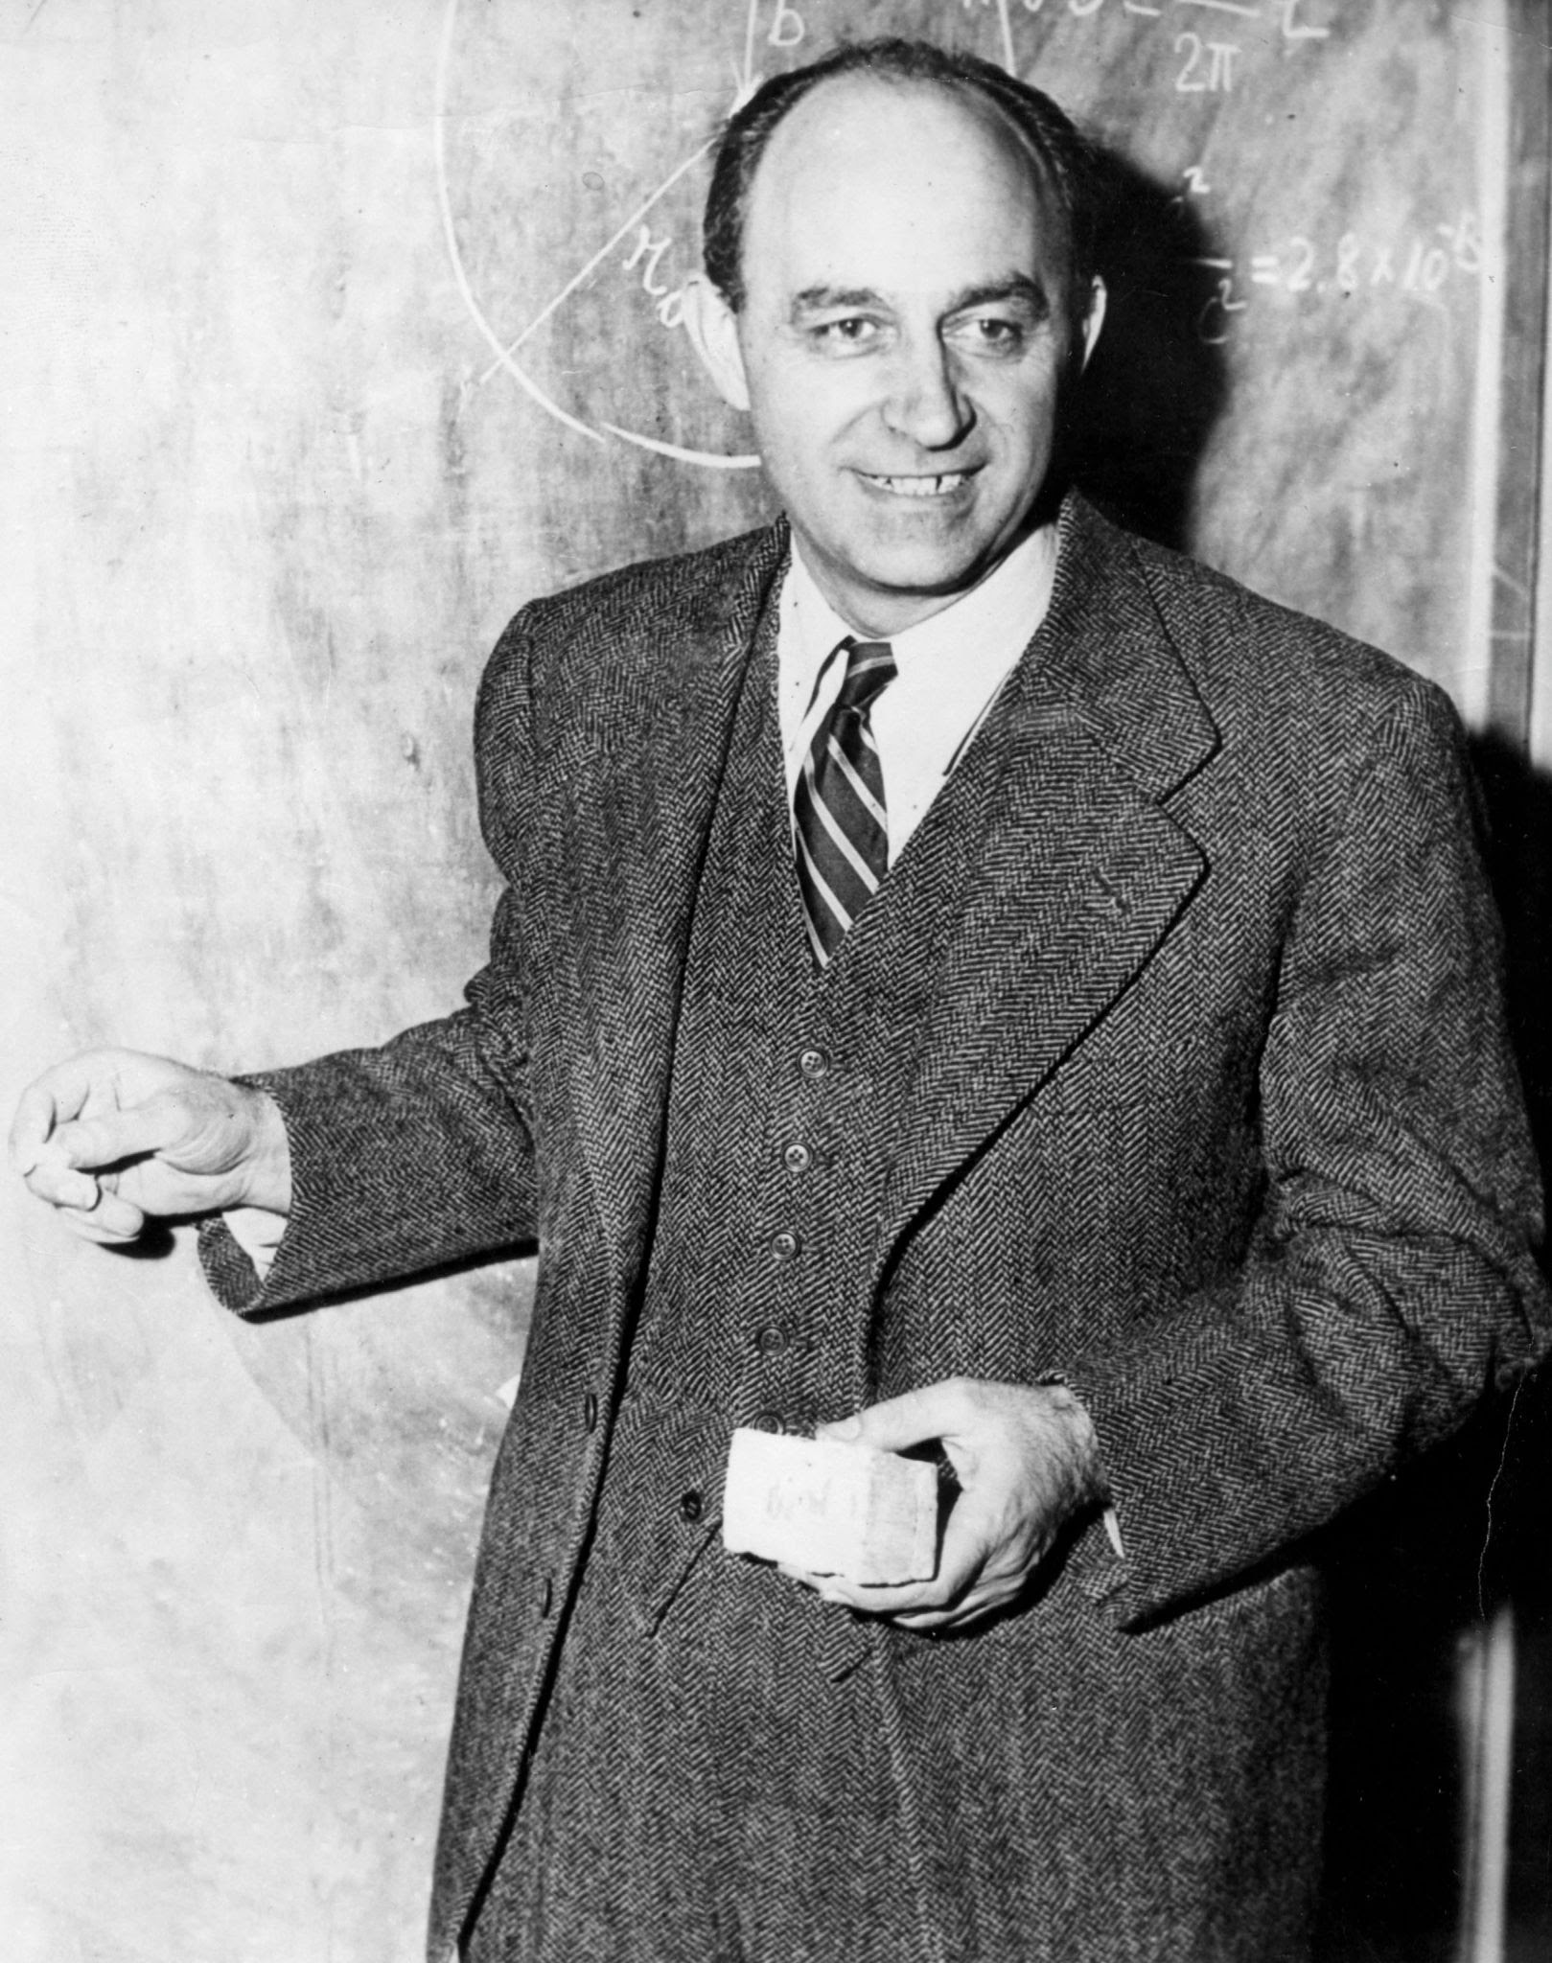
Fermi Theory
Fundamental theory of beta decays was developed by Fermi, through analogy with electromagnetism:
EM:
p⁺
β+ decay
n
p⁺
e⁺
p
e⁻
Weak charged currents
Electromagnetic currents
Enrico Fermi
e⁻
ν_{e}
(nb this is an era before Feynman diagrams… think instead about interacting currents)

Slide 9
Fermi Theory
Fundamental theory of beta decays was developed by Fermi, through analogy with electromagnetism:
EM:
p⁺
β+ decay
n
p⁺
e⁺
p
e⁻
Weak charged currents
Electromagnetic currents
Enrico Fermi
e⁻
ν_{e}
(nb this is an era before Feynman diagrams… think instead about interacting currents)
A corollary: if you know the rate of beta decay, you can know what the cross section for neutrinos to interact through inverse beta decay.
Hans Bethe and Rudolf Pierls did the calculation and found a crazy small cross section, concluding:
“there is no practically possible way of detecting the neutrino.“
Inverse β decay
n
p
e⁺
Weak charged currents
ν_{e}

Slide 10
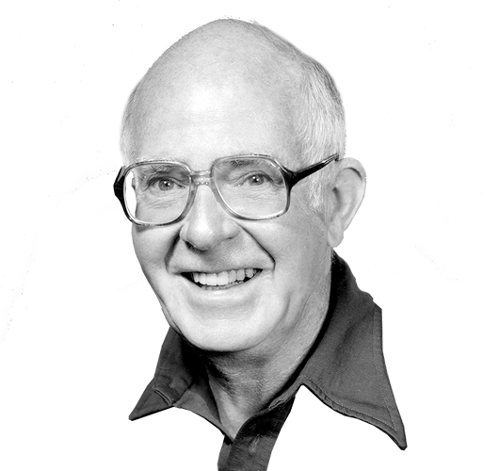
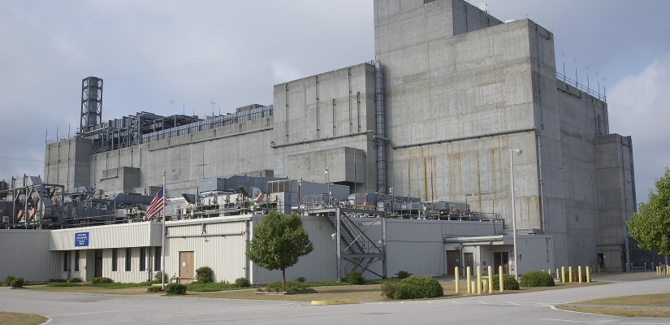
First attempt to discover the neutrino
Bruno Pontecorvo suggested using neutrino capture on chlorine from a nuclear reactor, an experiment first attempted by Ray Davis:
Ray Davis
Savannah river nuclear reactor – a copious source of neutrinos

Slide 11
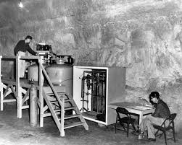
First attempt to discover the neutrino
Bruno Pontecorvo suggested using neutrino capture on chlorine from a nuclear reactor, an experiment first attempted by Ray Davis:
Ray Davis
Proposed process:
Cl

Slide 12
First attempt to discover the neutrino
Bruno Pontecorvo suggested using neutrino capture on chlorine from a nuclear reactor, an experiment first attempted by Ray Davis:
Ray Davis
Proposed process:
But it didn’t work…
Why not?

Slide 13
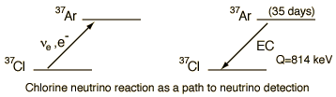
Go this way,
- Means adding more + to the nucleus
- Means making an e- to conserve charge
- Means absorbing a neutrino to conserve L
This process is only sensitive to neutrinos!
And reactors only make antineutrinos!

Slide 14
Go this way,
- Means adding more + to the nucleus
- Means making an e- to conserve charge
- Means absorbing a neutrino to conserve L
This process is only sensitive to neutrinos
And reactors only make antineutrinos!
Why?

Slide 15
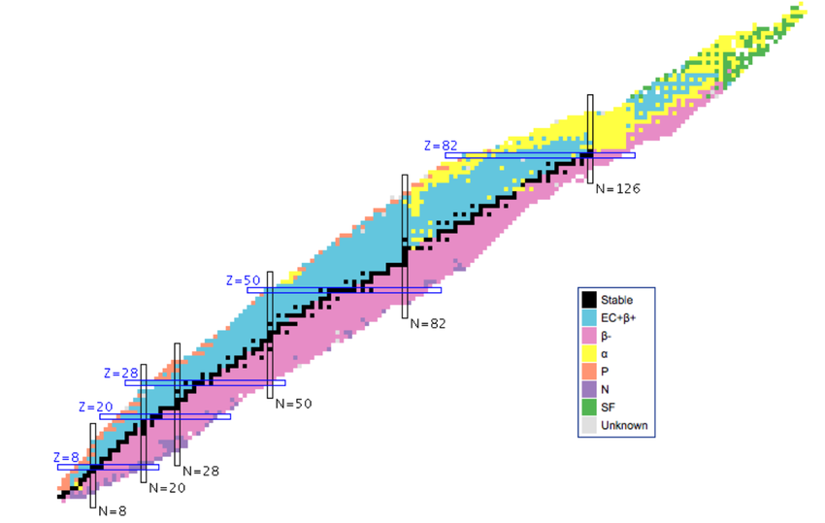
Proton # (Z)
Neuron # (N)

Slide 16
Stability
Proton # (Z)
Neuron # (N)

Slide 17
Too many neutrons, needs to b+ decay to turn some of them to protons
Just too damn heavy and falls to pieces
Proton # (Z)
Too many protons, needs to b- decay to turn some of them to neutrons
Neuron # (N)

Slide 18
N=Z
Proton # (Z)
Neuron # (N)

Slide 19
The more +ve charge a nucleus has, the more “neutron glue” you need to hold it together.
N=Z
Proton # (Z)
Neuron # (N)

Slide 20
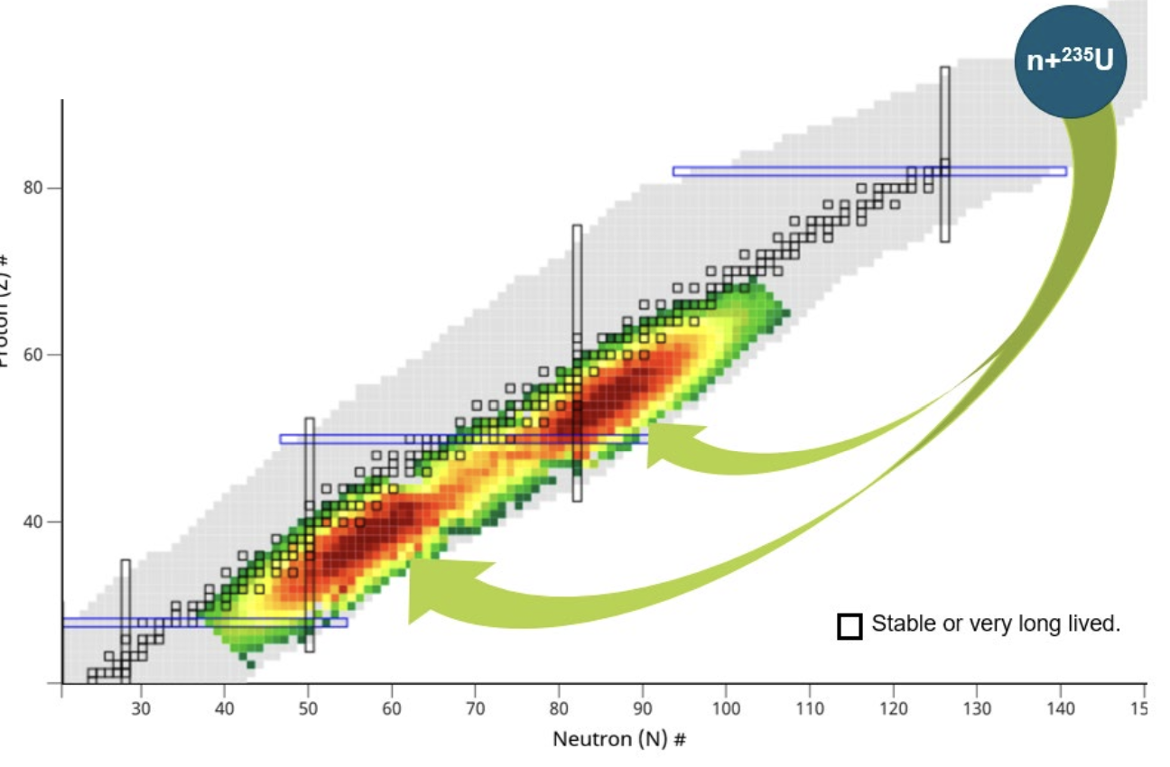
Nuclear Fission takes a nucleus which is very heavy and needs lots of neutron glue, to two that are lighter and need less.
Thus the fission fragments are always too neutron rich.

Slide 21
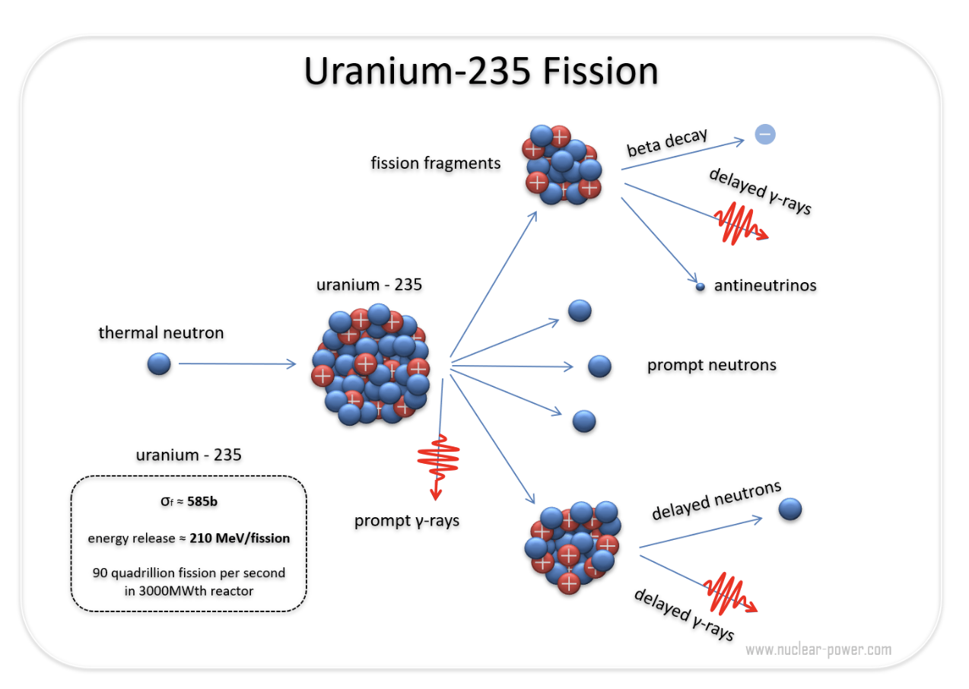
Fission
Proton #

Slide 22
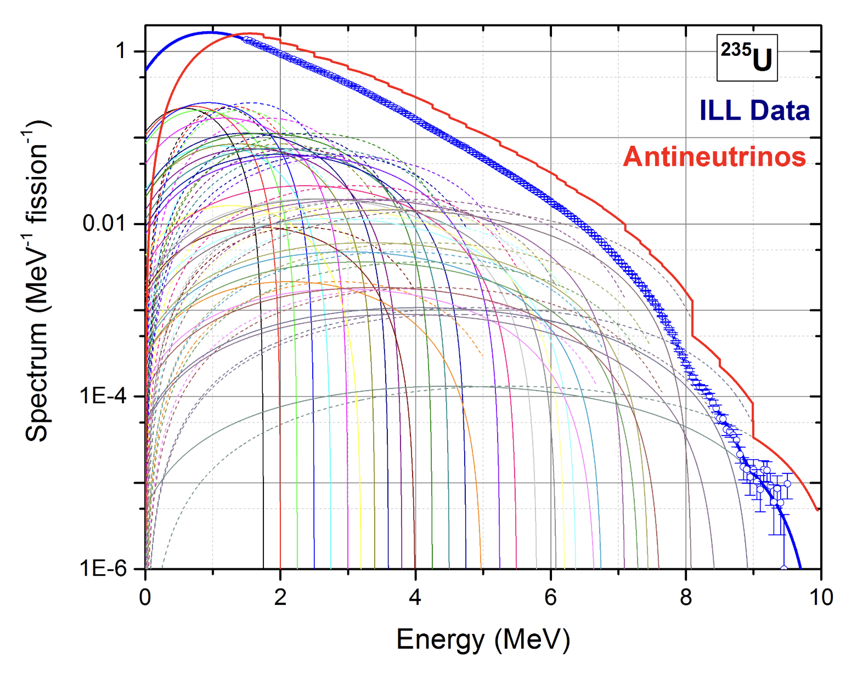
Those products then need to β- decay to get back to stability.
And that makes antineutrinos.
Proton #
Beta Decay

Slide 23
He’ll be back soon →
Ray Davis

Slide 24
In the mean time… How about we use a detector that can see antineutrinos?
Neutrinos can be detected via
Inverse beta decay in liquid scintillator
Inverse β decay
Try to see these
n
p
e⁺
Weak charged currents
ν_{e}

Slide 25
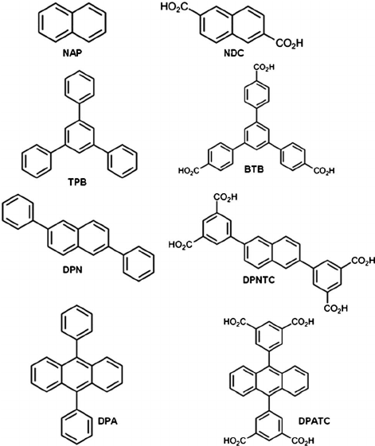
In the mean time… How about we use a detector that can see antineutrinos?
Neutrinos can be detected via
Inverse beta decay in liquid scintillator
Liquid scintillator is a bunch of this kind of crap that emits light when charged particles go through it →

Slide 26
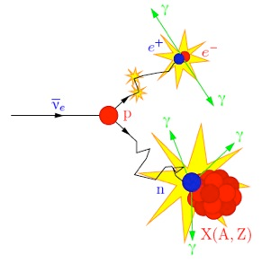
In the mean time… How about we use a detector that can see antineutrinos?
Neutrinos can be detected via
Inverse beta decay in liquid scintillator
You get a handy “double pulse” signature from an inverse beta decay event:
Positron scintillates and then
Neutron thermalizes and captures

Slide 27
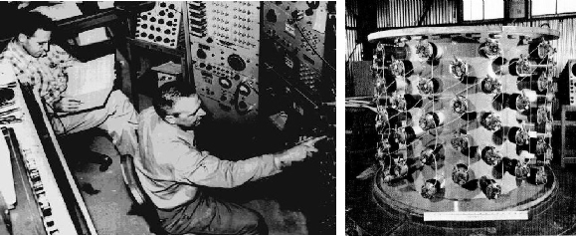
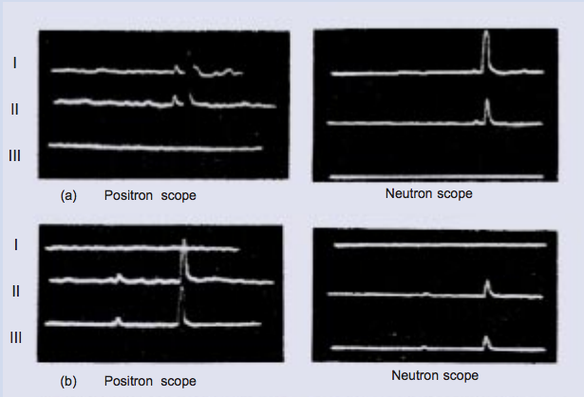
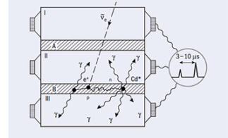
the neutrino discovered by project poltergeist
Detected 1955
with
reactor antineutrinos and organic scintillator.
Plus cameras that took photos of oscilloscopes.
Boom boom, there it is →

Slide 28
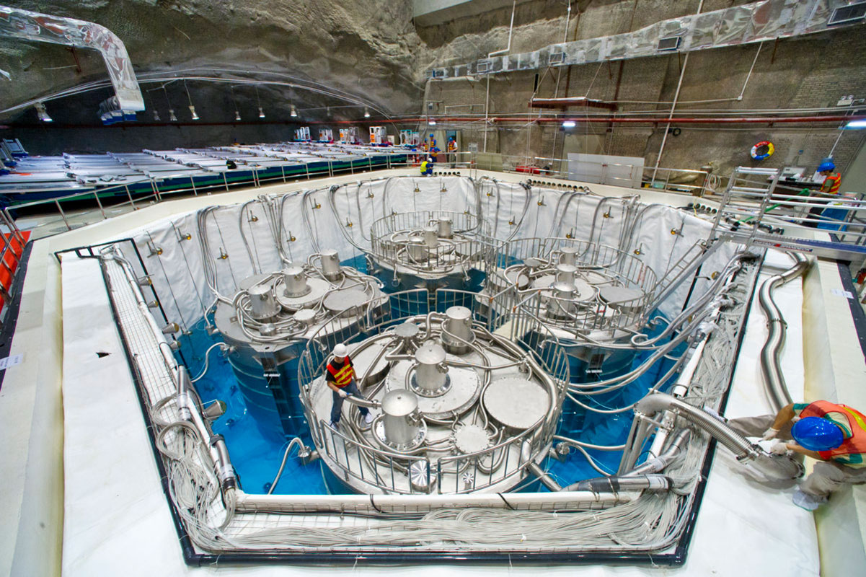
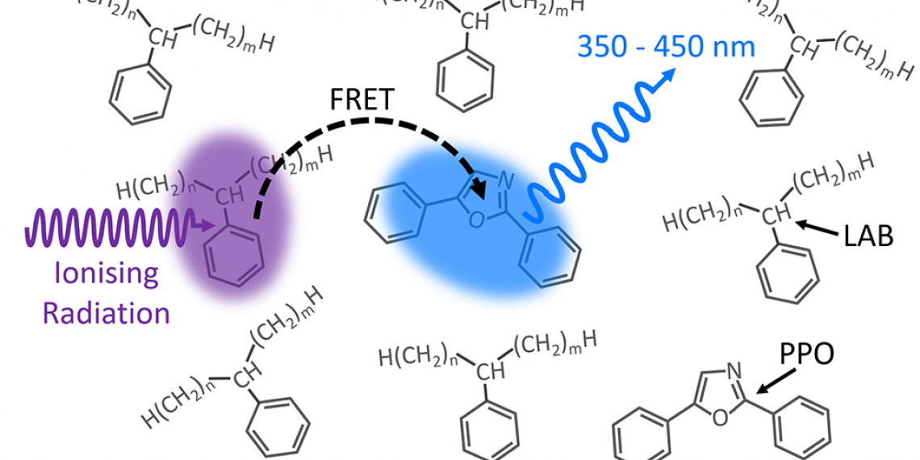
Apart from using more complex mixtures of scintillating stuff, this is still basically exactly how all reactor neutrino experiments in all of history have worked…

Slide 29
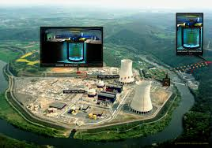
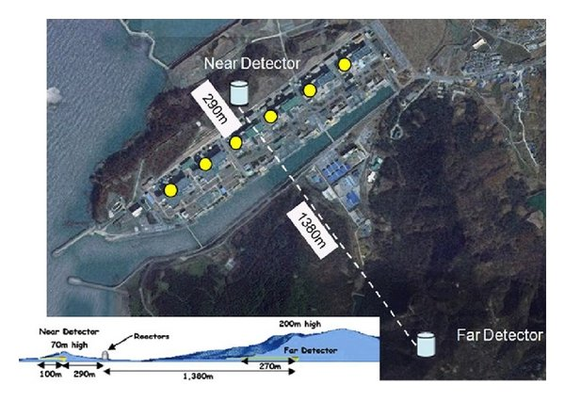
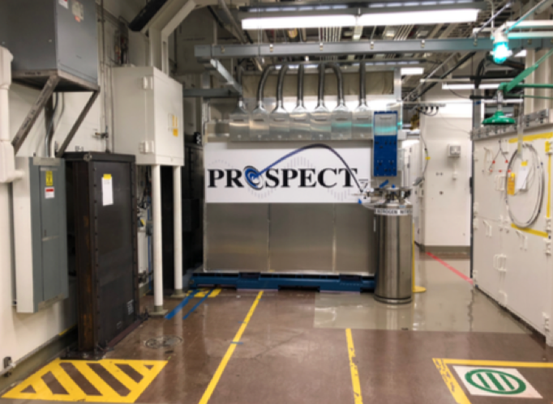
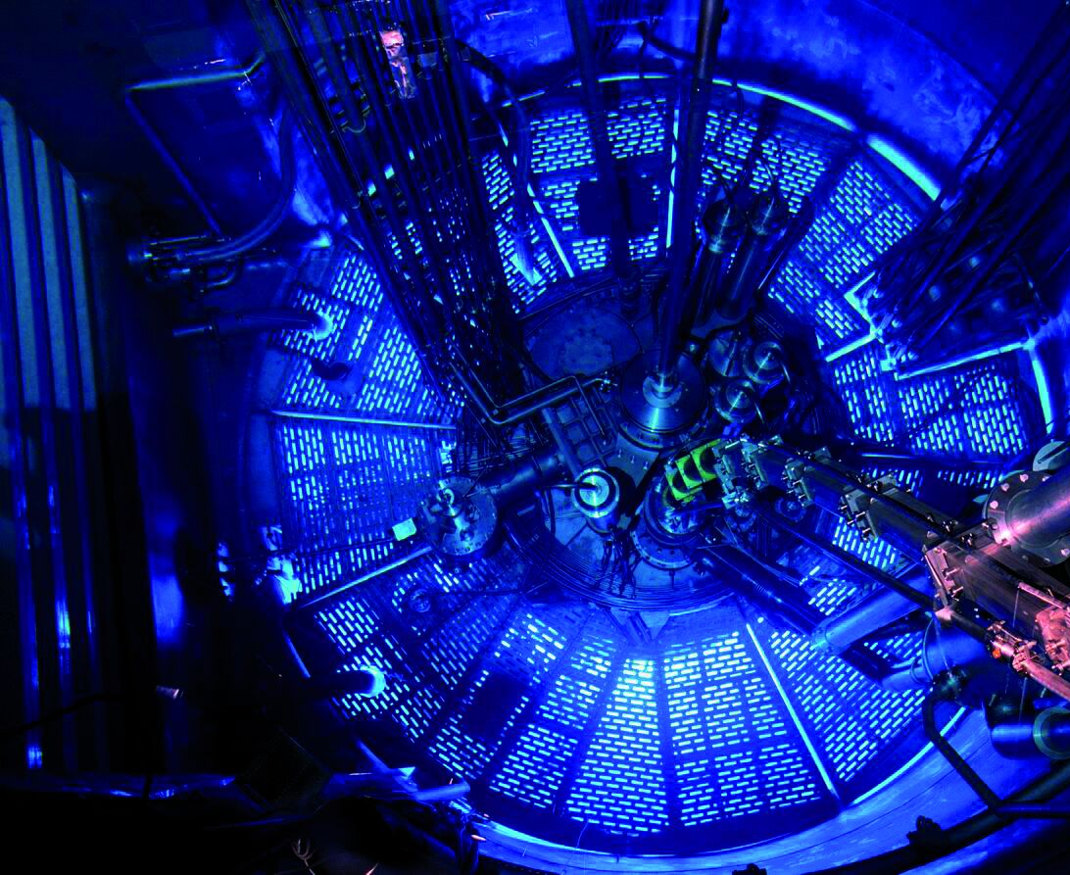
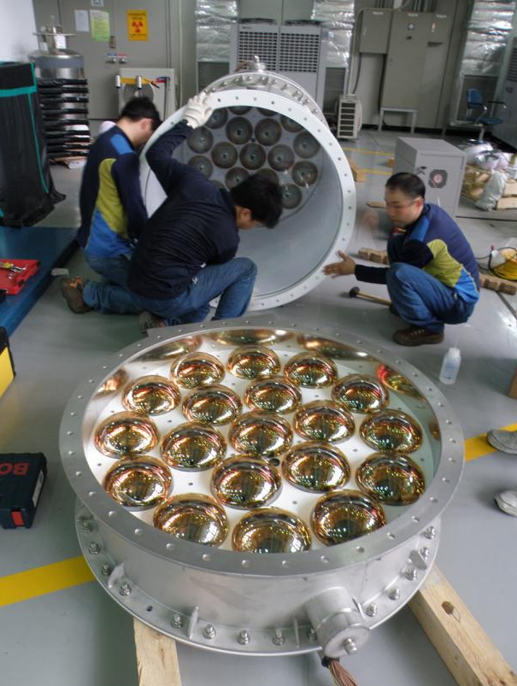
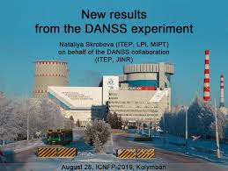
RENO
RENO
Double CHOOZ
Daya Bay
STEREO
PROSPECT
DANSS
NEOS

Slide 30
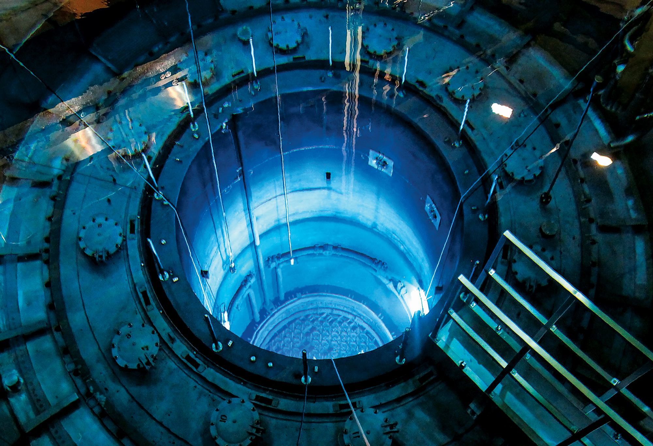
We have been detecting antineutrinos from beta decays in nuclear reactors for 65 years.
We must be basically perfect at it by now, right?

Slide 31
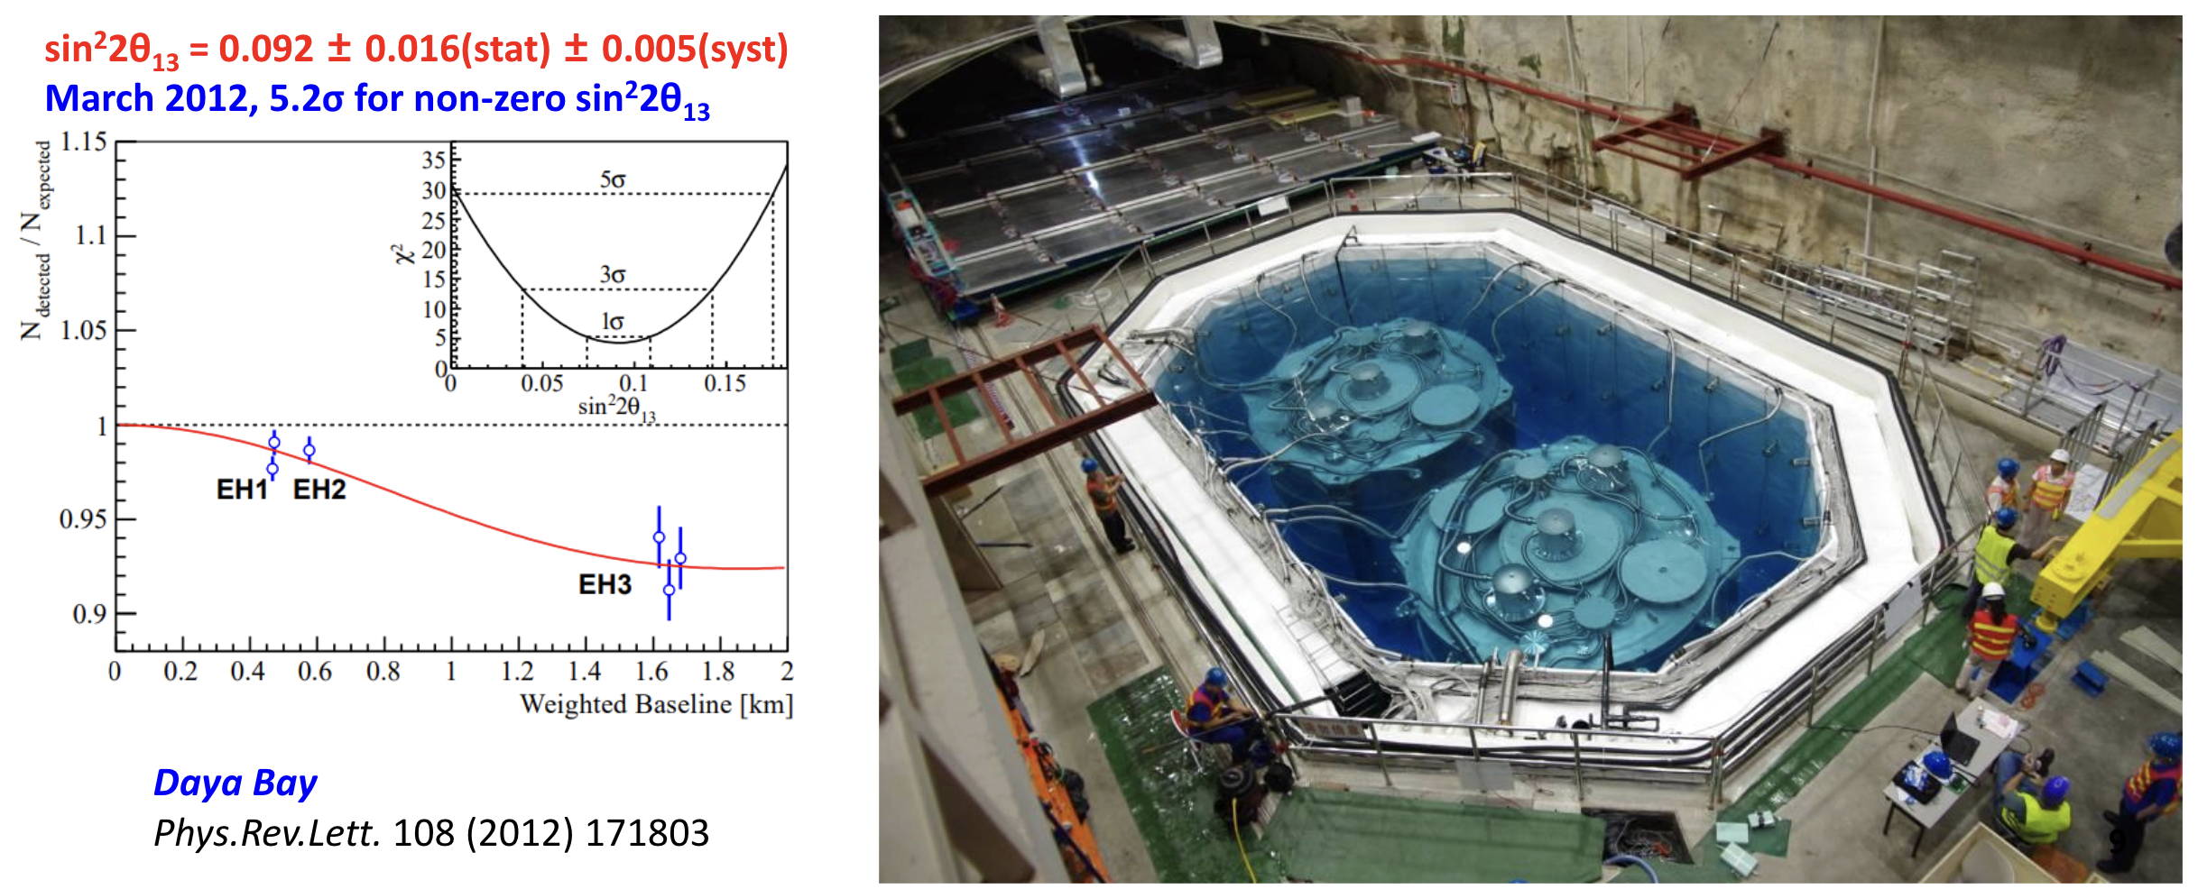
best oscillation measurement ever:
Evidence in favor:
We have used reactor antineutrinos to measure oscillation parameter
And is the best measured neutrino oscillation parameter ever.
(more on this when we talk about neutrino oscillations later)

Slide 32
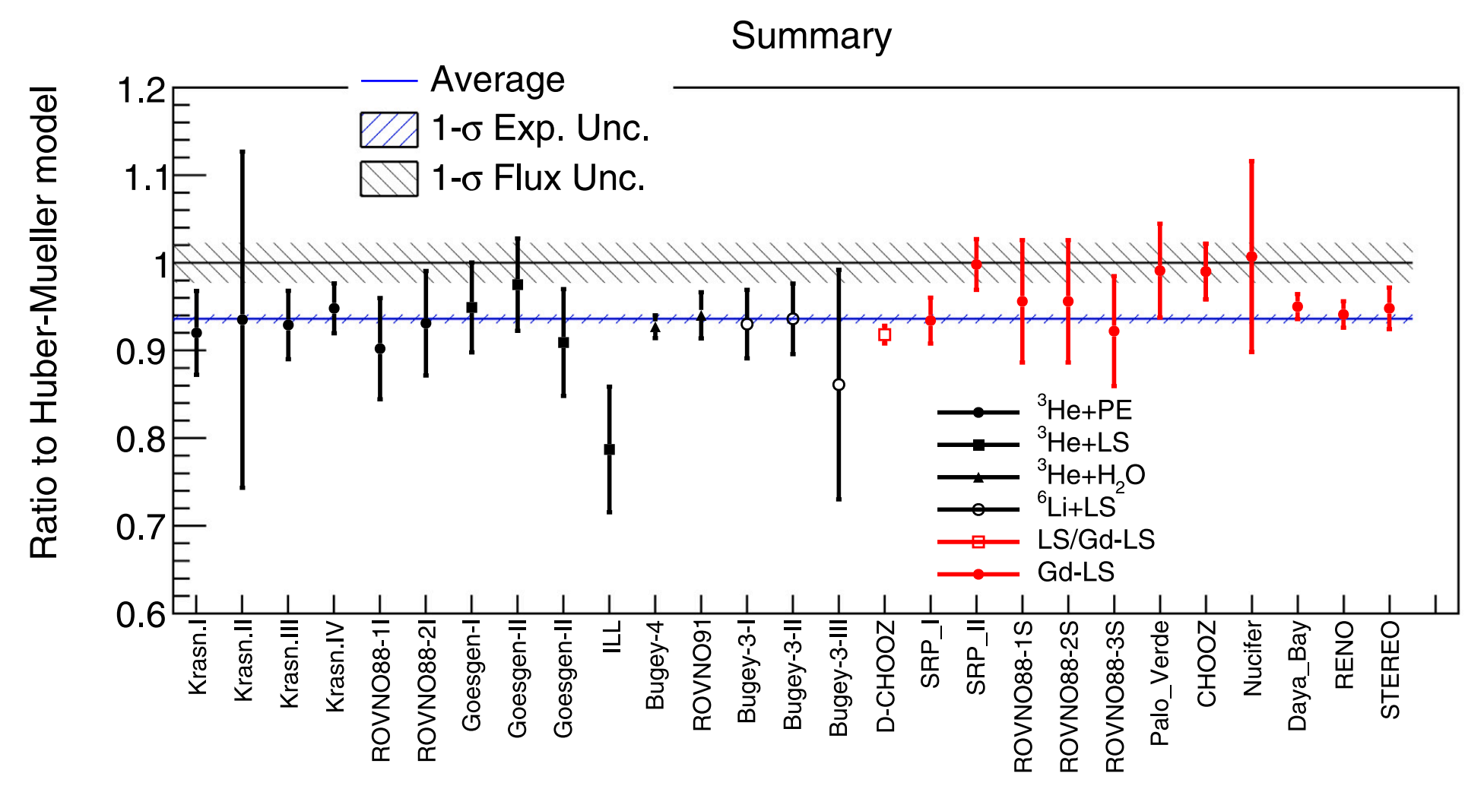
all is not well if we measure the fluxes
Evidence against:
There is a general tendency for world data on neutrino rates to be low compared to flux predictions.
A tangled story, mostly related to evolving theory: Used to be fine, then it was much worse, now its still an significant disagreement but less than before...
This discrepancy is called the Reactor Antineutrino Anomaly (RAA)

Slide 33
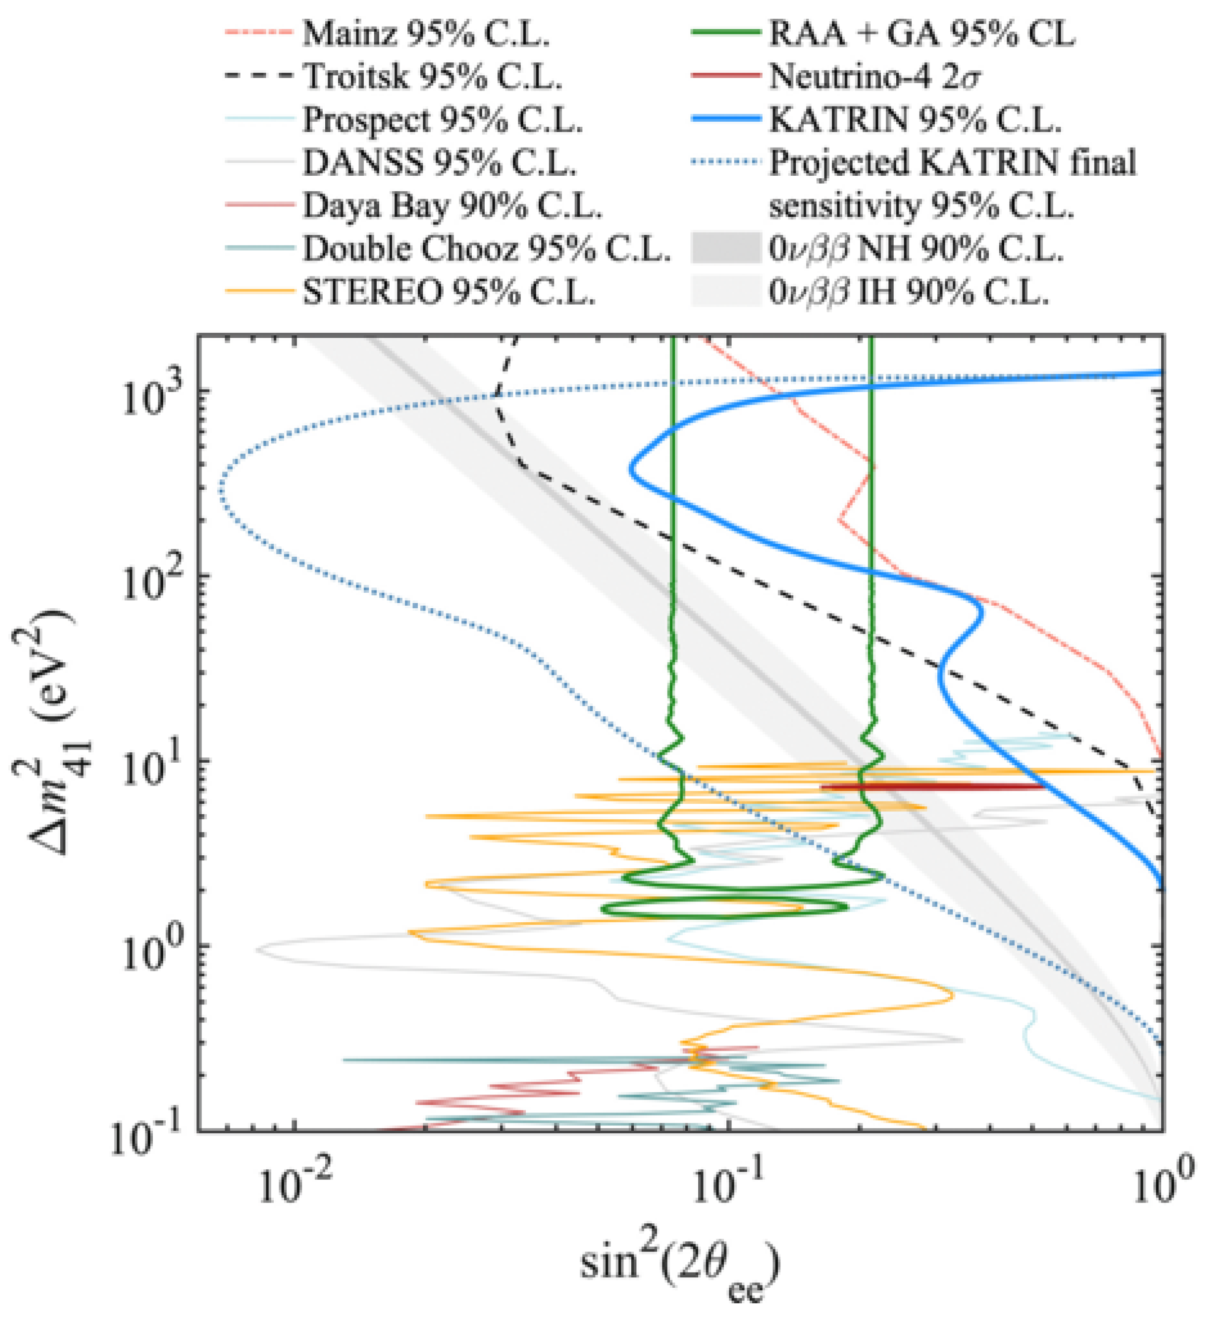
New physics at reactors
Some have interpreted the RAA as evidence for new physics in neutrino oscillations.
The RAA has generally been among the weaker of the neutrino anomalies, since the calculations of the fluxes are both:
1. very involved and
2. have a history of significantly changes between iterations.

Slide 34
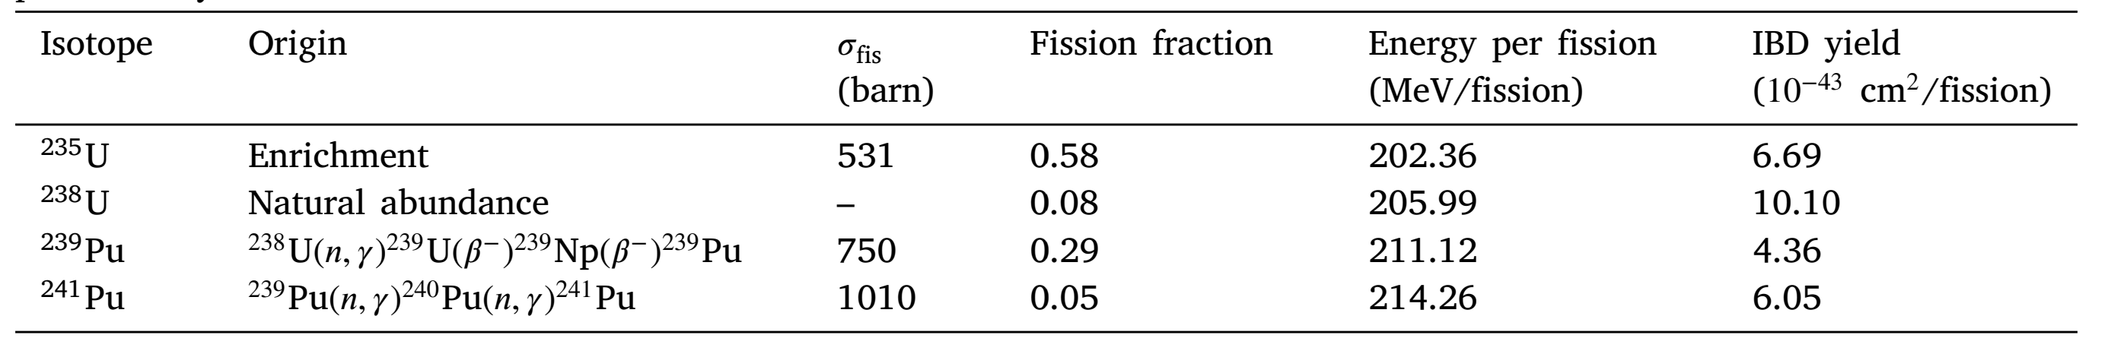
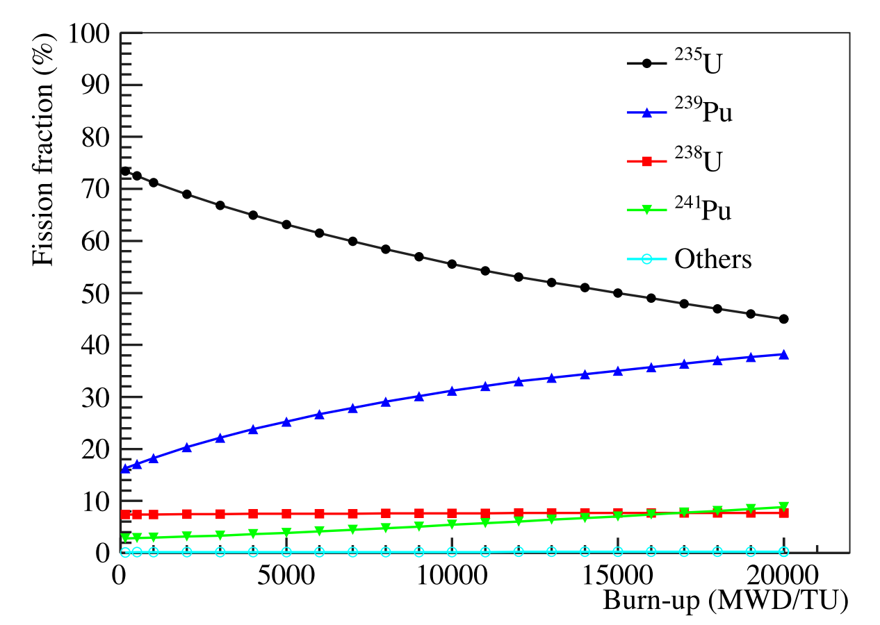
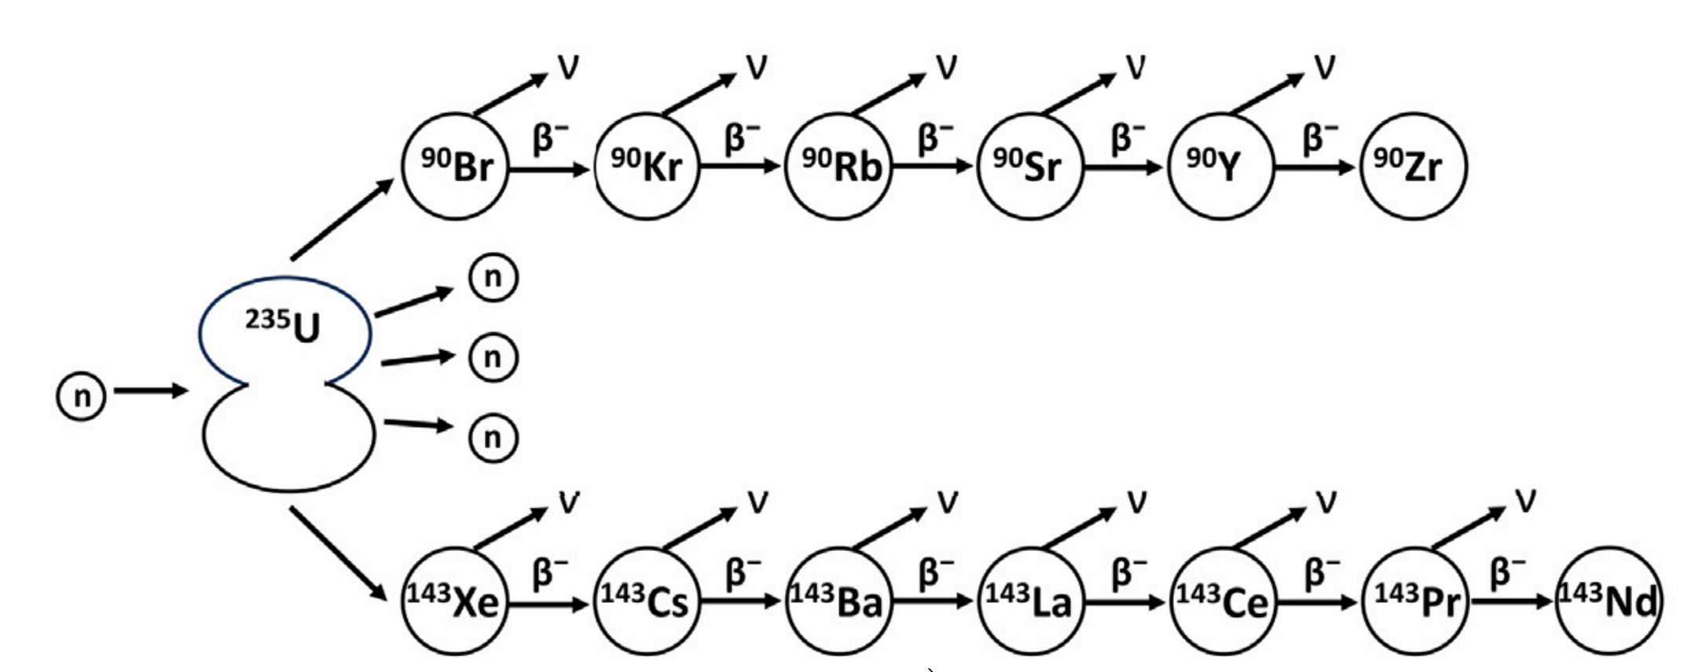
Neutrino flux depends on state of the reactor fuel.
²³⁵U is the main fissile isotope.
As reactor operates, other fissile materials build up, with their own fission patterns →
Each fission creates ~200MeV of energy and a chain of decays yielding approx. 6 antineutrinos.

Slide 35
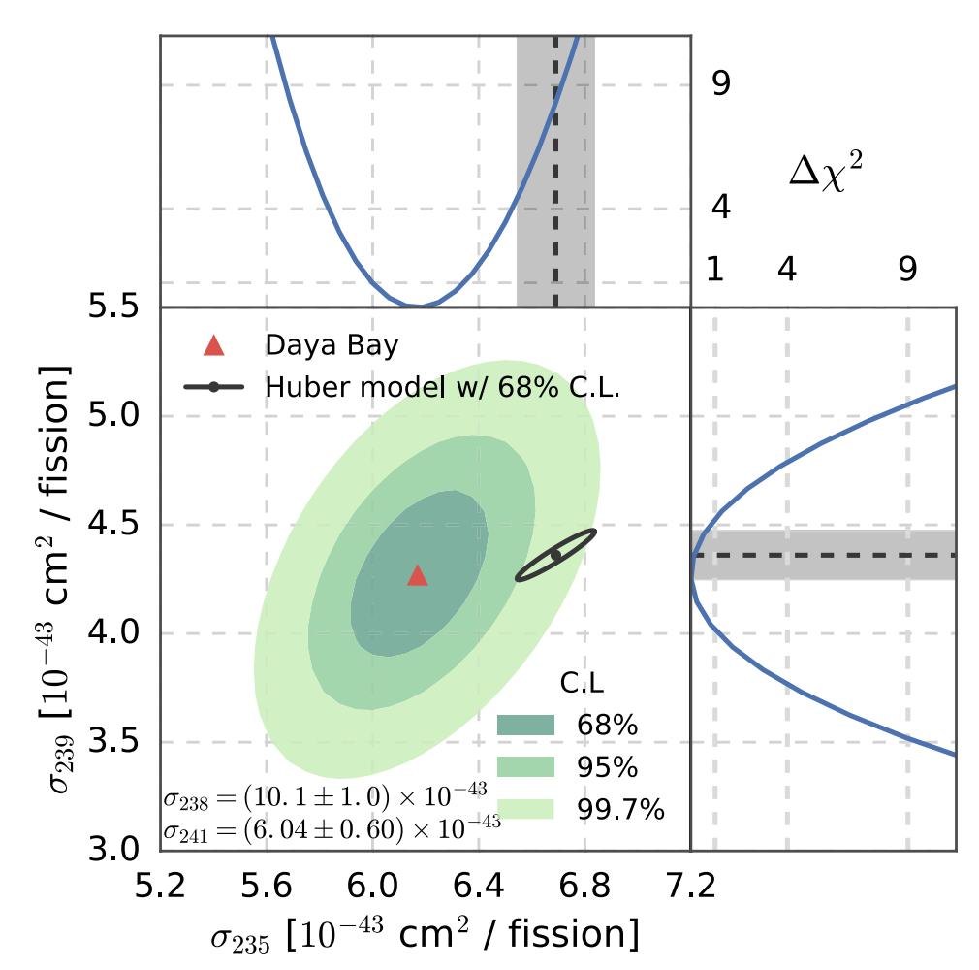
Resolving the RAA?
Daya Bay has observed that the strength of the RAA depends on the ratio of fissile isotopes during burnup.
- Consistent with ²³⁵U neutrinos being underpredicted
- Not consistent with new neutrino oscillation physics.

Slide 36
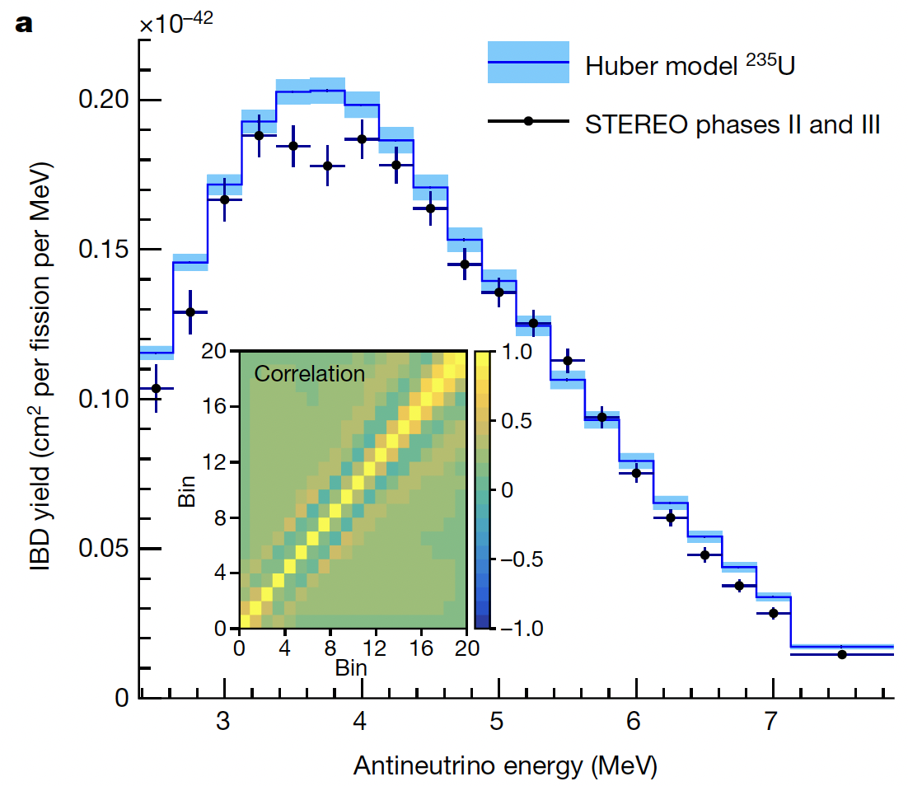
Research reactors
Research reactors are mostly ²³⁵U, vs commercial power reactors which mix up the isotopes.
STEREO confirms underprediction in the ²³⁵U neutrino yields.

Slide 37
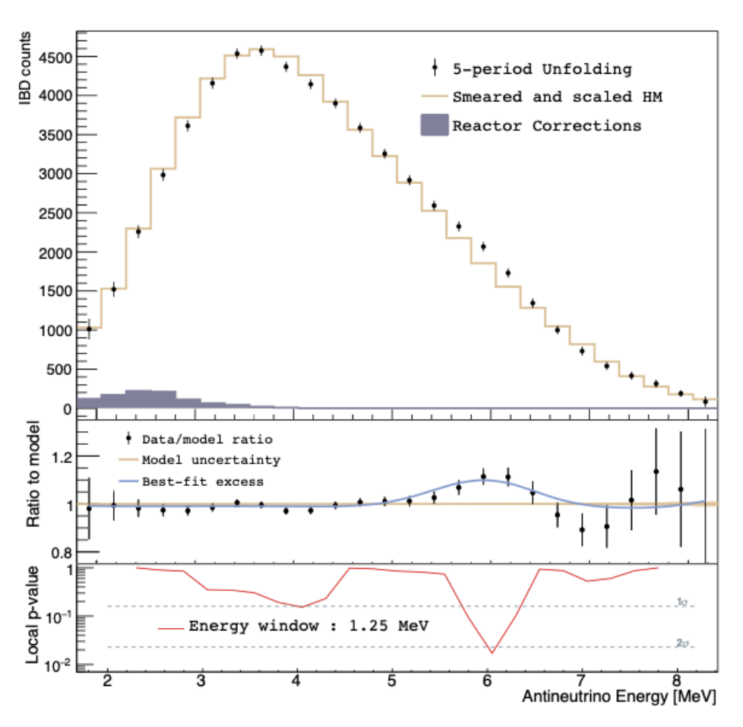
Research reactors
Research reactors are mostly ²³⁵U, vs commercial power reactors which mix up the isotopes.
STEREO confirms underprediction in the ²³⁵U neutrino yields.
Prospect data seem to be low but maybe not quite low enough…
→ Seems rather likely that ²³⁵U neutrino flux model is the issue.

Slide 38
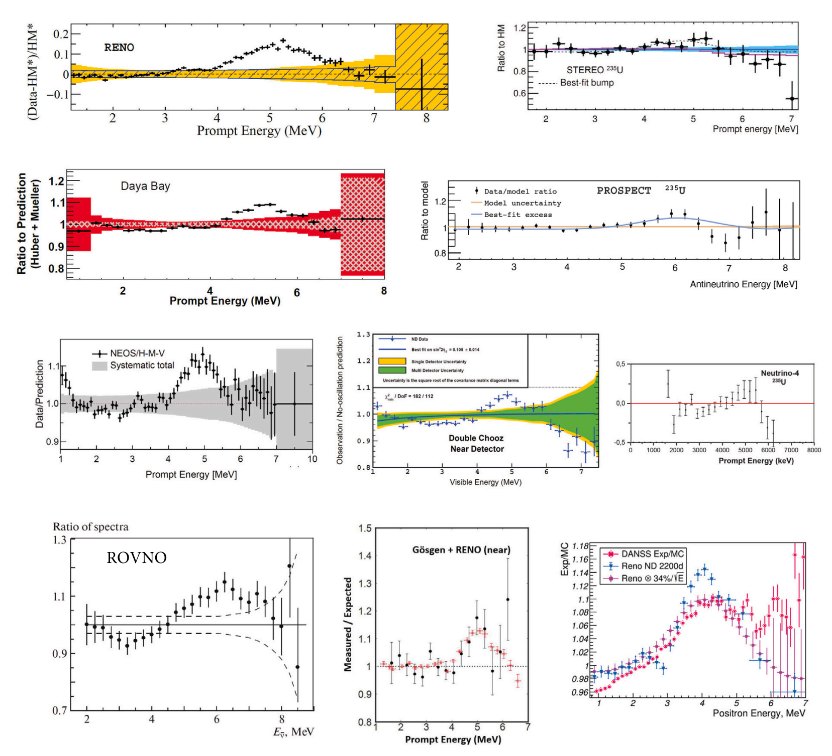
Oh yeah, also this weird bump at 5 MeV…
That basically every reactor experiment sees.

Slide 39

Nuclear physics is difficult
If you wanted your PhD to be easy, you should have worked on exoplanets.

Slide 40

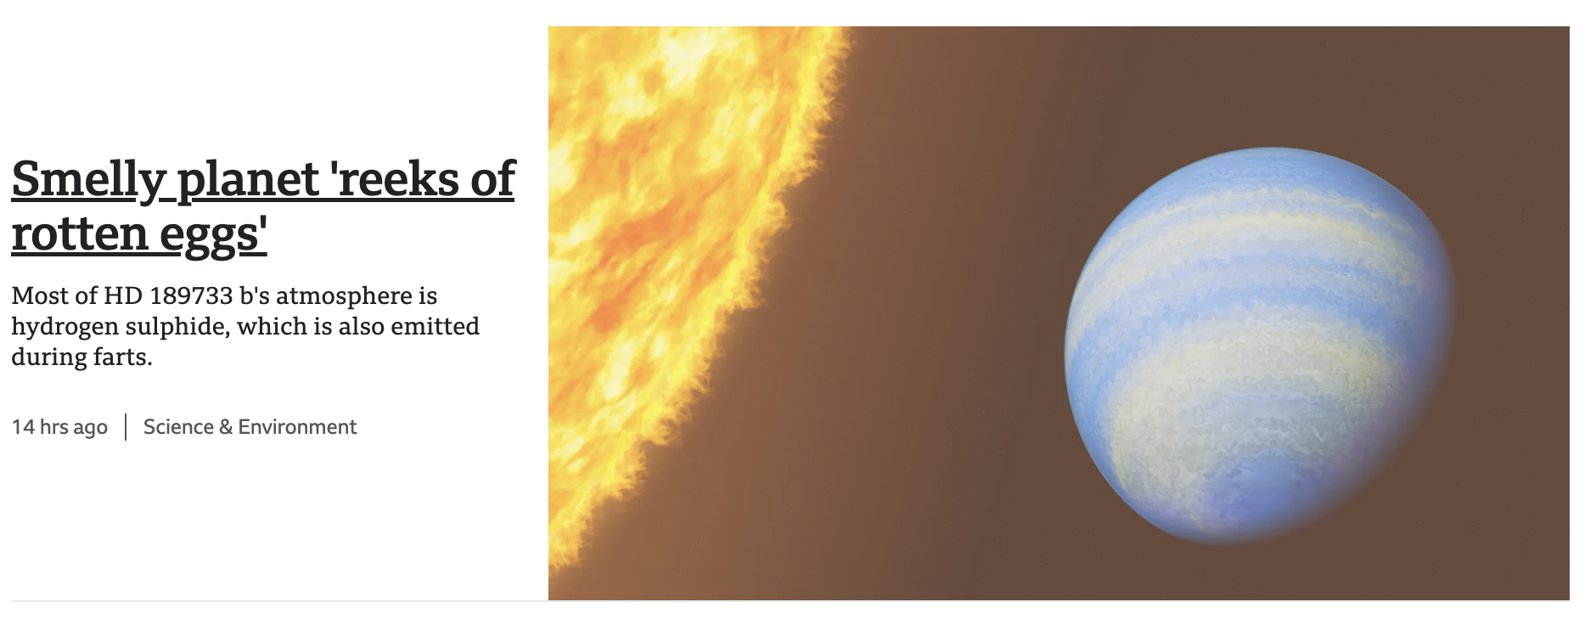
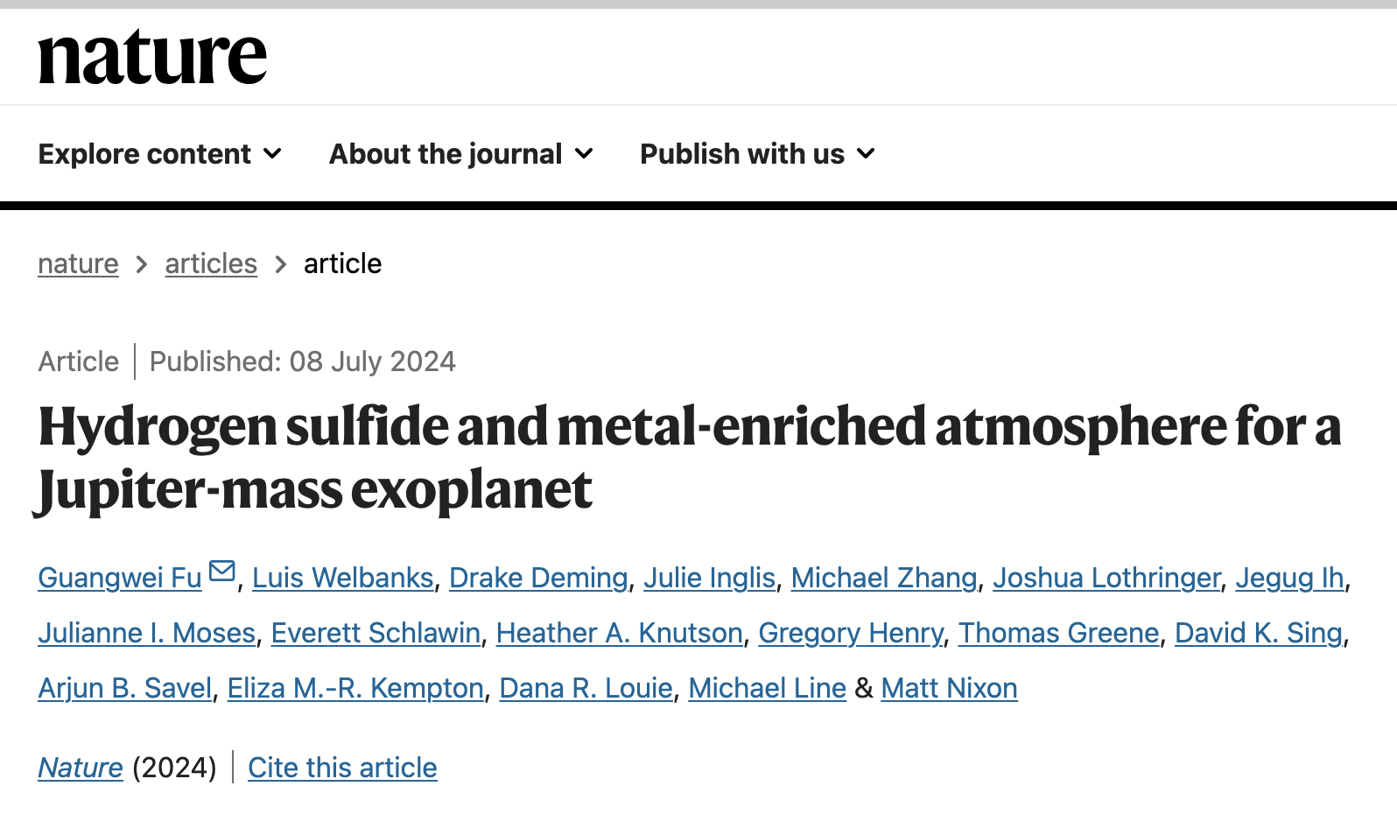
(BBC news and Nature, literally last week)

Slide 41
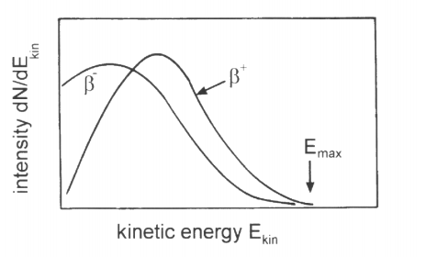
Experiments with a single isotope
The reason reactor spectra are so hard to predict is that they derive from an enormously complex chain of nuclear reactions.
Those reactions stem from fission to nearly every possible element and decay chains ~6 deep from there.
If we do experiments with just a single beta emitting isotope, that should be easy, right?

Slide 42
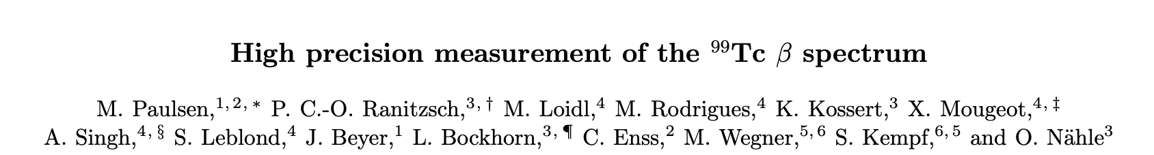
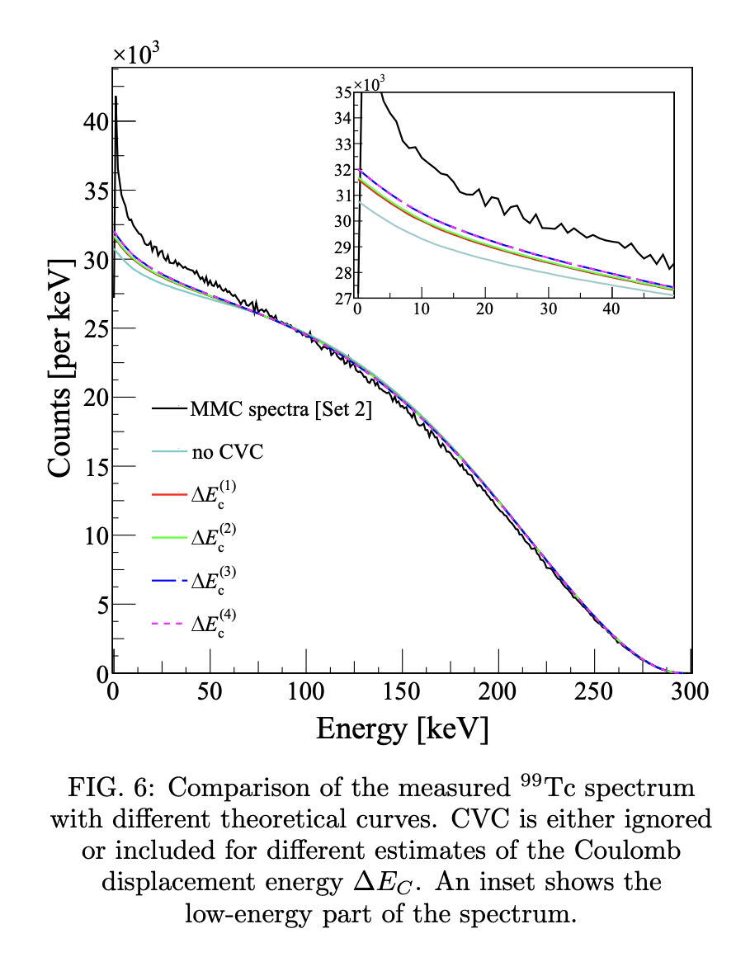
Experiments with a single isotope
Well… maybe…
Nuclear modelling very complex in this part of the spectrum, especially for heavy isotopes.
We’ll return to these difficulties when we talk about double beta decay…

Slide 43
Experiments with a single isotope
At least down here it looks ok…

Slide 44
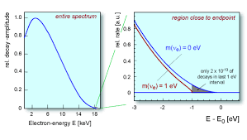
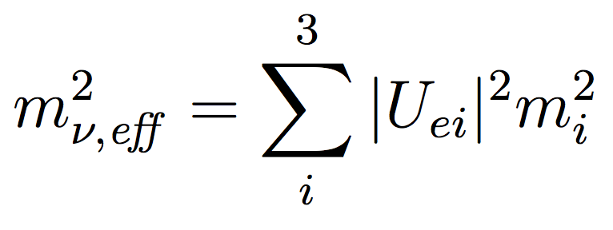
The beta endpoint
The the end-point, shape is dictated primarily by phase space arguments, not by nasty nuclear physics.
And it is a particularly interesting part of the beta spectrum for neutrino physics…
The size of the mass of the neutrino changes the shape and position of the endpoint, in measurable way.
LETS DERIVE IT!
The size of the deviation is governed by this effective parameter

Slide 45

TIME FOR MATH INTERLUDE 1

Slide 46
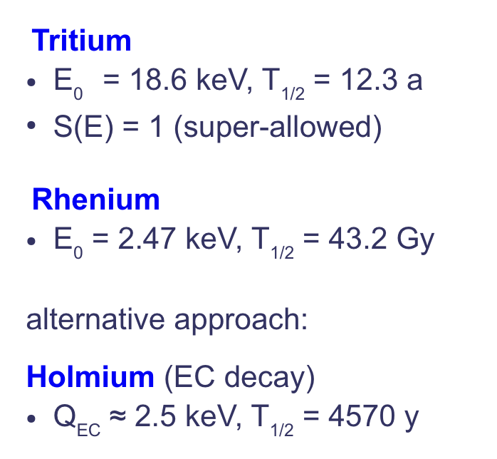
Measuring the beta end point
Experimentally, we need to measure a shape deviation that occurs in the last ~1eV of the spectrum.
The lower the Q value we use, the larger the fraction of decay events that will be.
To have any hope at all, use a very low Q value isotope:

Slide 47

How to build an experiment…
Still need to reject all except 10⁻¹² of the beta electrons to look at the ones we care about…
Use some kind of “filter” to only accept the high energy electrons, perhaps?
ALL THIS IS TRASH
We only care about this

Slide 48

How To catch only the fast ones…
Apply an electric field against the electrons to sap their energy away… then only the higher energy ones can pass?
V
E=dV/dx
x

Slide 49
How To catch only the fast ones…
Apply an electric field against the electrons to sap their energy away… then only the higher energy ones can pass?
The problem is they come out in all directions… need to turn them all to face the same way first, somehow.
V
E=dV/dx
x
V
How can you turn them all to face the same way without giving or taking any energy?
x

Slide 50

MAC-E FILTERING
Magnetic Adiabatic Collimation combined with an Electrostatic Filter
Detector
A MAC-E filter adiabatically rotates the electron momentum directions and then applies the potential filter.
A frightfully clever way of adiabatically rotating all the electrons to face the same way using E and B fields

Slide 51

KATRIN MAC-E filter
Leopoldshafen, Germany
(near Karlsruhe)
November 2006
10¹¹ tritium decays/s
B-field range 3 - 60000 G
ΔE = 0.93 eV
Design sensitivity: 0.2 eV @ 90% CL

Slide 52


Slide 53


Slide 54


Slide 55

KATRIN new limit as of Neutrino2024:

Slide 56
NEXT gen: do another one 10x as big?
Leopoldshafen, Germany
(near Karlsruhe)
November 2006
10¹¹ tritium decays/s
B-field range 3 - 60000 G
ΔE = 0.93 eV
Design sensitivity: 0.2 eV @ 90% CL

Slide 57




another way to filter…
1) An electron in a magnetic field will radiate at
2) And a radiofrequency cavity naturally filters out a band around the resonant frequency…
Cyclotron radiation emission spectroscopy in an RF cavity → Project 8

Slide 58

Electron tracks in Project 8
Trap tritium inside the cavity and let it decay there.
Measure response in frequency space near the end point.
Electron tracks slope up because of cyclotron losses
And they step because of random inelastic scatters.

Slide 59

From Neutrino2024:

Slide 60


Atomic and molecular tritium
T
To extend further in sensitivity, another challenge faces tritium experiments.
When T2 molecule decays, it makes a THe molecule, which has vibrational excited states.
The excitation absorbs a random amount of energy, effectively smearing the end-point.
T
T
T
He
He
He
T
T
T
T

Slide 61


Atomic tritium
Its easy to make T from T2 – just heat it up and it cracks!
But if you let it touch any surfaces, it will recombine back to T2…
Need to cool to 1 mK (somehow) and store in a magnetic bottle.
T
T
T
T
T2 to T cracks on hot tungsten (2200K)
Accommodator
(cool by scattering)
T binds to solid surfaces (~10K)
MECB
(cool by evaporation
T gravitationally storable in 3m trap (~1mK)

Slide 62


Cooling t
Multipole atom guide
A major ongoing research area in Project 8 (including in my own group, and at IU!)
Can’t access any tritium lines with powerful enough lasers for laser cooling.
Also can’t let it touch any surfaces or it will recombine to T2.
Proposed solution is magnetic evaporative cooling from multipole magnetic guides →
Only the highest energy atoms escape magnetic potential.

Slide 63

Holmium electron capture
¹⁶³Ho undergoes electron capture decay with a very low Q-value (2.5 keV).
The neutrino leaves, and the rest of the energy comes out through various de-excitation processes.
For holmium electron capture decay, the neutrino mass can in principle be measured through calorimetry.

Slide 64




Microcalorimetry
¹⁶³Ho accelerated and implanted into absorber →
Radioisotope
Absorber
Thermometer
Thermal link
← Then heat depositions read out via precise thermometry:
Holmes: Transition Edge Sensors
Echo: Magnetic Micro-calorimeters
Heat sink
(sub-Kelvin)

Slide 65

Outlook
From Neutrino2024:

Slide 66
Summary
Neutrinos were invented as a “desperate remedy” to understand the energy spectrum of beta decay.
They were then detected via beta decays from fission products in reactors.
The end-point of beta decay is a powerful tool to try to measure the absolute value of the neutrino mass.
We have much work to do, both experimentally and theoretically, to understand the ~130 year old beta decay process.

